Slide 1
Fact file
Zeus

Slide 2
fact
1.He is the god of thunder
2.He rules the gods of mount Olympus
3.His name is cognate
4.His mythologies and powers are smellier
5.Thay are not identical

Slide 3
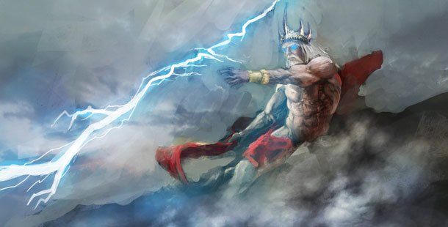

Slide 4
What does he do
Zeus is the sky and thunder god in ancient Greece religion, who rules as king of the gods of Mount Olympus. Zeus is the leader of gods. He is the god of gods in Greece.

Slide 5
What does he protect
Zeus protects assemblies of people, councils,
and families.

