Slide 2
Diving into Mastery Guidance for Educators
Each activity sheet is split into three sections, diving, deeper and deepest, which are represented by the following icons:
These carefully designed activities take your children through a learning journey, initially ensuring they are fluent with the key concept being taught; then applying this to a range of reasoning and problem-solving activities.
These sheets might not necessarily be used in a linear way. Some children might begin at the ‘Deeper’ section and in fact, others may ‘dive straight in’ to the ‘Deepest’ section if they have already mastered the skill and are applying this to show their depth of understanding.
Diving
Deeper
Deepest

Slide 3
Aim
Read Roman numerals to 100 (I to C) and know that over time, the numeral system changed to include the concept of 0 and place value.

Slide 4
Roman Numerals to 100
Diving
Complete the table using Roman numerals, numbers and words.
Roman Numeral | Number | Words
 |  | three
 | 50
XLVIII
LXXXVII
 | 99
III
3
L
fifty
48
forty-eight
87
eighty-seven
XCIX
ninety-nine

Slide 5
Roman Numerals to 100
Diving
Circle each Roman numeral in the hundred square.
VII
XXIV
XLI
XC
XCIII
XVI
LXIX
1 | 2 | 3 | 4 | 5 | 6 | 7 | 8 | 9 | 10
11 | 12 | 13 | 14 | 15 | 16 | 17 | 18 | 19 | 20
21 | 22 | 23 | 24 | 25 | 26 | 27 | 28 | 29 | 30
31 | 32 | 33 | 34 | 35 | 36 | 37 | 38 | 39 | 40
41 | 42 | 43 | 44 | 45 | 46 | 47 | 48 | 49 | 50
51 | 52 | 53 | 54 | 55 | 56 | 57 | 58 | 59 | 60
61 | 62 | 63 | 64 | 65 | 66 | 67 | 68 | 69 | 70
71 | 72 | 73 | 74 | 75 | 76 | 77 | 78 | 79 | 80
81 | 82 | 83 | 84 | 85 | 86 | 87 | 88 | 89 | 90
91 | 92 | 93 | 94 | 95 | 96 | 97 | 98 | 99 | 100

Slide 6
Roman Numerals to 100
Diving
Complete the number sequences using Roman numerals.
20 |  | 18 | 17 |  | 15
XIX
XVI
XIV
 | XV | XX | XXV
X
XXX
XXXV
XL

Slide 7
Roman Numerals to 100
Deeper
Marcus has two wooden sticks. He wants to rearrange the sticks to make different Roman numerals. Which Roman numerals can he use these sticks to represent?
Find as many possibilities as you can.
Number | Roman Numeral | Number of Sticks Used
1
I
1
2
II
2
5
V
2
10
X
2
50
L
2

Slide 8
Roman Numerals to 100
Deepest
Flavia has part of a hundred square. Can you spot and explain the mistake in Flavia’s hundred square?
LXXI |  | LXXI
LXXXI | LXXXII | LXXXIII
LXXXXI |  | XCIII
LXXXXI
Flavia has written 91 incorrectly. She has tried to make the number using four ten symbols in a row. With Roman numerals, there should never be more than three of the same symbol in a row. 90 is represented as XC (100 - 10 = 90) so 91 should be written as XCI.

Slide 9
Roman Numerals to 100
Deepest
Here is another part of the hundred square. Fill in the missing Roman numerals.
 | LXXIX
 |  | XC
LXXXVIII
LXXXIX
XCIX

Slide 10
Roman Numerals to 100
Deepest
Antonia has written the number 31 using Roman numerals.
IIIX
Can you explain her mistake? What is the correct way to write it?
Antonia has got her tens and ones the wrong way around. To write 31, she should have written XXXI.

Slide 11
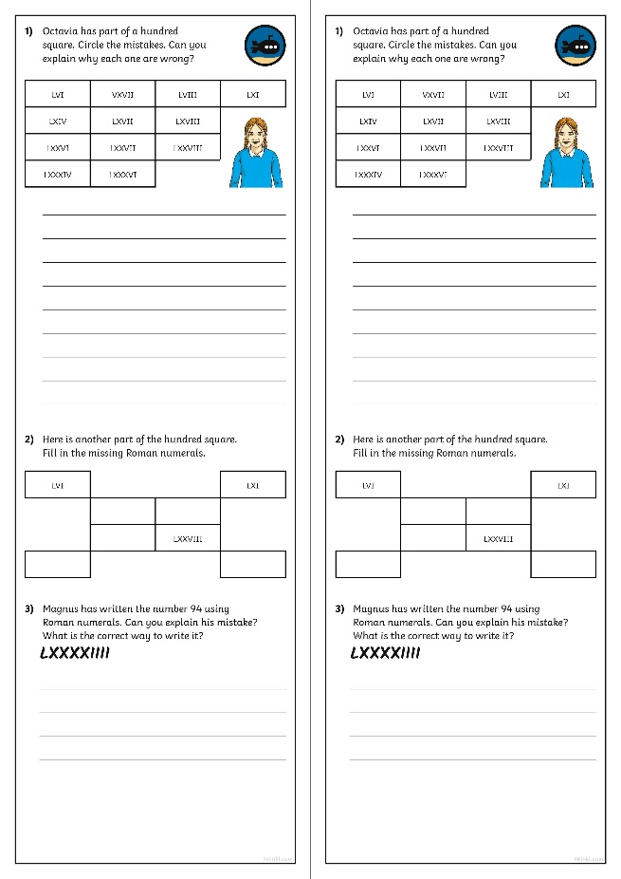
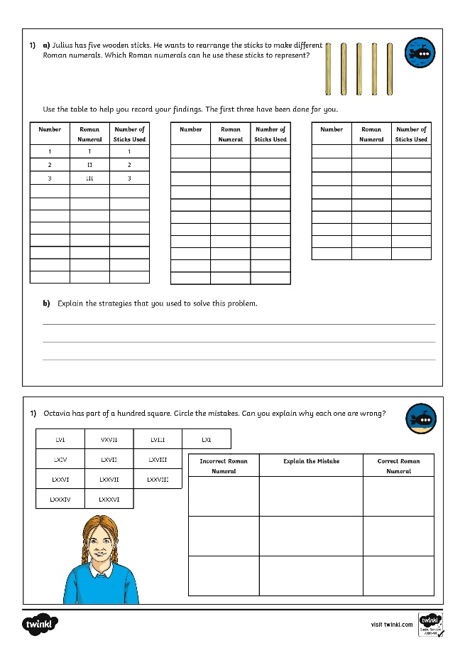
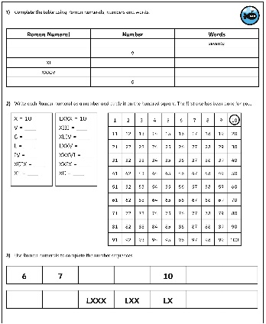
Roman Numerals to 100
Dive in by completing your own activity!

Slide 12
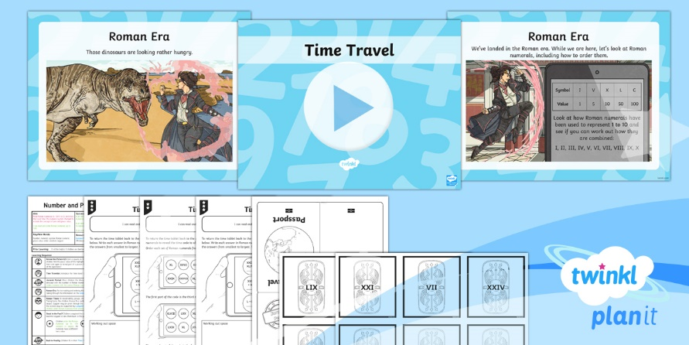
Need Planning to Complement this Resource?
National Curriculum Aim
Read Roman numerals to 100 (I to C) and know that over time, the numeral system changed to include the concept of zero and place value.
For more planning resources to support this aim, click here.
Twinkl PlanIt is our award-winning scheme of work with over 4000 resources.

