Slide 1
1000
2000
3000

Slide 2
Diving into Mastery Guidance for Educators
Each activity sheet is split into three sections, diving, deeper and deepest, which are represented by the following icons:
These carefully designed activities take your children through a learning journey, initially ensuring they are fluent with the key concept being taught; then applying this to a range of reasoning and problem-solving activities.
These sheets might not necessarily be used in a linear way. Some children might begin at the ‘Deeper’ section and in fact, others may ‘dive straight in’ to the ‘Deepest’ section if they have already mastered the skill and are applying this to show their depth of understanding.
Diving
Deeper
Deepest

Slide 3
Aim
Order and compare numbers up to 10 000.

Slide 4
Number Lines to 10 000
Diving
Look at the number line below and identify the missing numbers.
.
0
10 000
1000
5000
8500

Slide 5
Number Lines to 10 000
Diving
Identify the numbers in the middle of these number lines.
.
7000
9000
8000
.
4550
4560
4555
.
4200
5200
4700

Slide 6
Number Lines to 10 000
Deeper
.
7460
C
Circle the letter that represents 7400.
B
A
7360

Slide 7
.
10 000
Number Lines to 10 000
Deeper
.
1000
Look at these number lines. What is the same? What is different? Explain your thinking.
Similarities
Both lines start with 0.
Both lines have 10 intervals.
Both lines have an arrow pointing to the middle of the line.
Both lines only have the starting number and end number revealed.
0
Differences
Both lines end with different numbers.
One line is vertical and the other is horizontal.
The intervals on each line are worth different values. The intervals on the vertical line have a value of a 100. The intervals on the horizontal line have a value of a 1000.
The arrow on the vertical number line is worth 500 while the arrow on the horizontal number line is worth 5000.
0

Slide 8
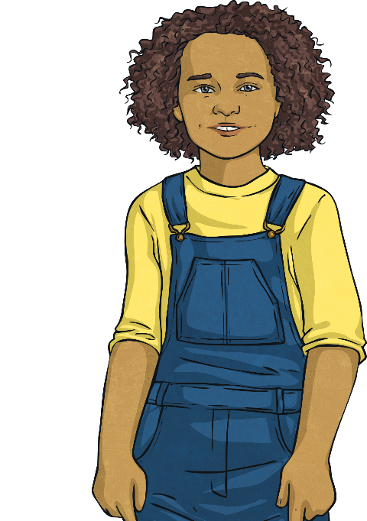
Number Lines to 10 000
Deeper
Look at the number line below and read the statements. Who is correct? Explain your thinking.
.
5000
7000
Anya
Nathan
Jing
I think the arrow is pointing to 10 000.
I think the arrow is pointing to 6000.
I think the arrow is pointing to 5800.
Anya is incorrect. The number line only reaches 7000 so 10 000 wouldn’t be recorded on this line.
Nathan is correct. The arrow is halfway between 5000 and 7000 so must be 6000.
Jing is incorrect. Each interval is worth 200 so 5800 would be one interval to the left.

Slide 9
Number Lines to 10 000
Deepest
If 8000 is present on each of these four number lines, what could the start and end of the number lines be? Where would 8000 be?
.
.
8100
7000
8000
8000
Accept any correct number lines, such as:
.
.
0
10 000
7995
8005
8000
8000
Explain how you solved the problem.
Accept any explanation that shows that if the intervals are consistent, the start and end numbers could be anything.
.

Slide 10
Number Lines to 10 000
Deepest
Pick a four-digit number and place it on each of these number lines.
.
4000
5000
4650
.
4600
4700
4650
.
4649
Accept any correct number line. For example: 4650
4650

Slide 11
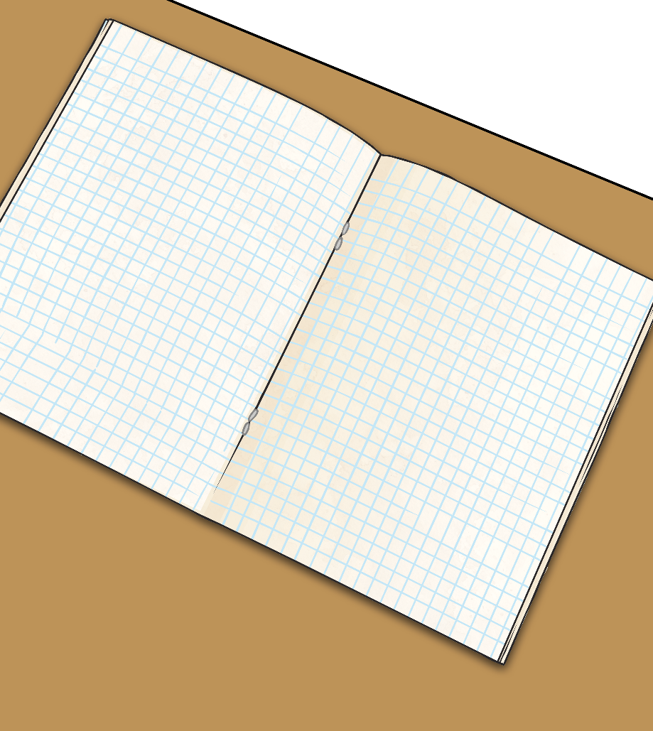
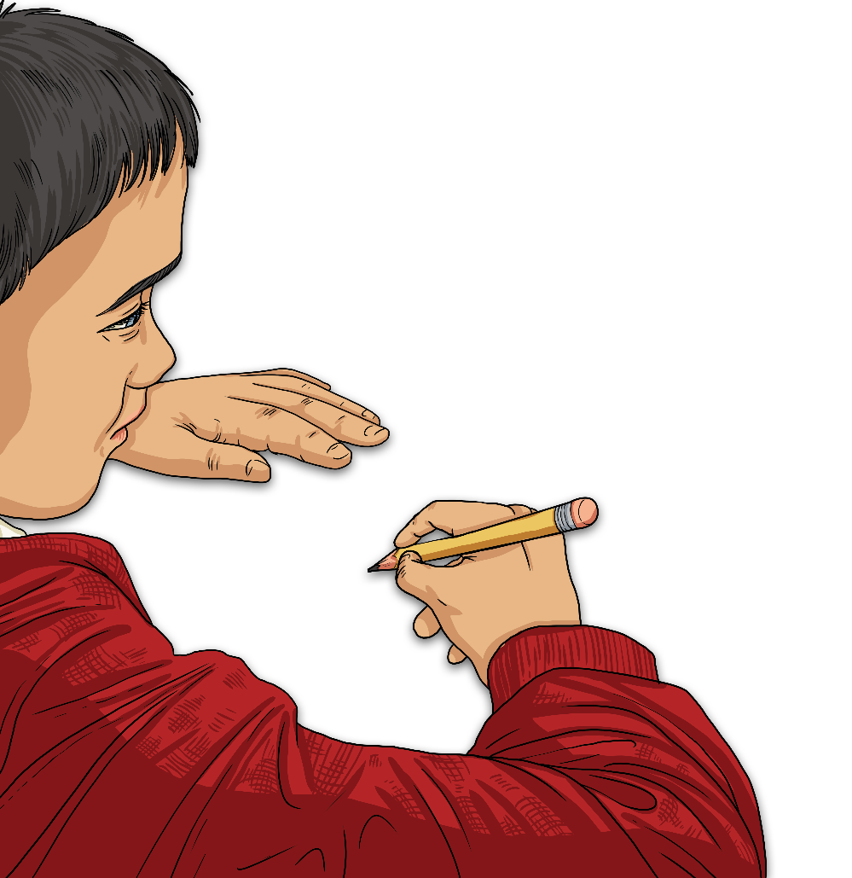
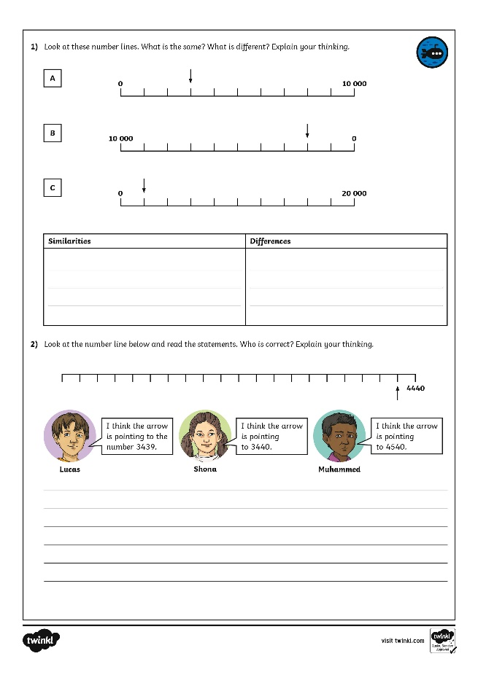
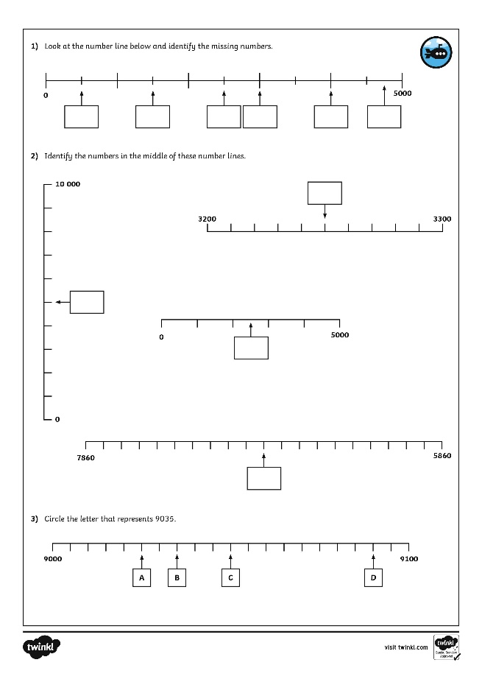
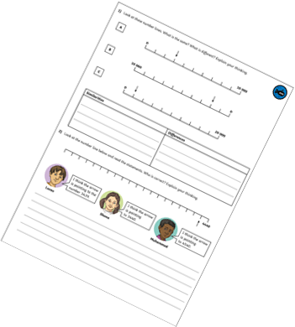
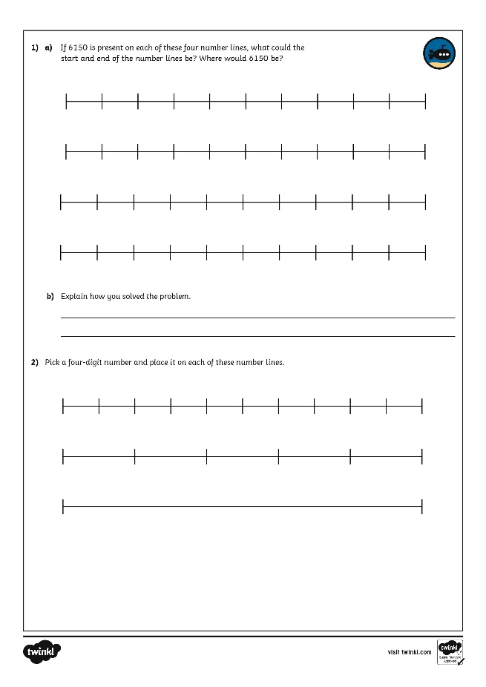
Number Lines to 10 000
Dive in by completing your own activity!

Slide 12
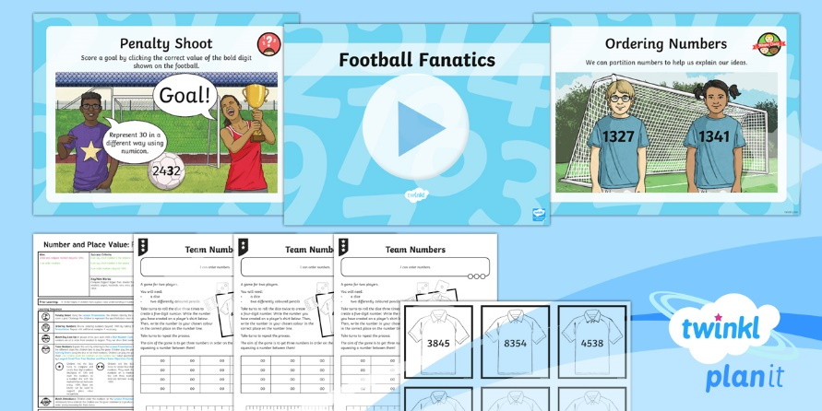
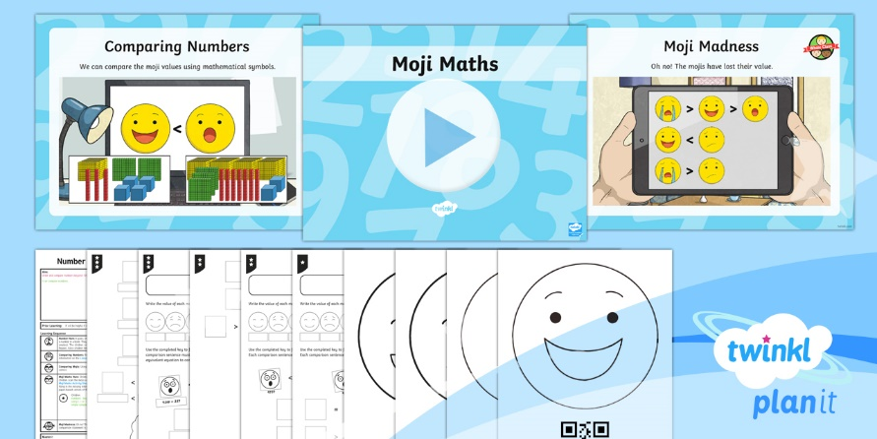
Need Planning to Complement this Resource?
National Curriculum Aim
Order and compare numbers beyond 1000.
For more planning resources to support this aim, click here.
Twinkl PlanIt is our award-winning scheme of work with over 4000 resources.

