Slide 1
The Next Chapter
By Oliver Bridges

Slide 2
Oh no! Athena became anxious at the thought of getting into trouble with Professor Homer for not finding the scroll's and bring them to him. Athena looked at Apollo and Artemis and asked "Will you both come and help me get the scrolls for Professor Homer please?" Apollo smiled and said "Sure." Artemis nodded in agreement.
"Where are the scrolls being kept?" Asked Artemis.
"In the Library" Said Athena
Apollo grimaced " I heard that Uncle Hades had left Cerberus to guard them"

Slide 3
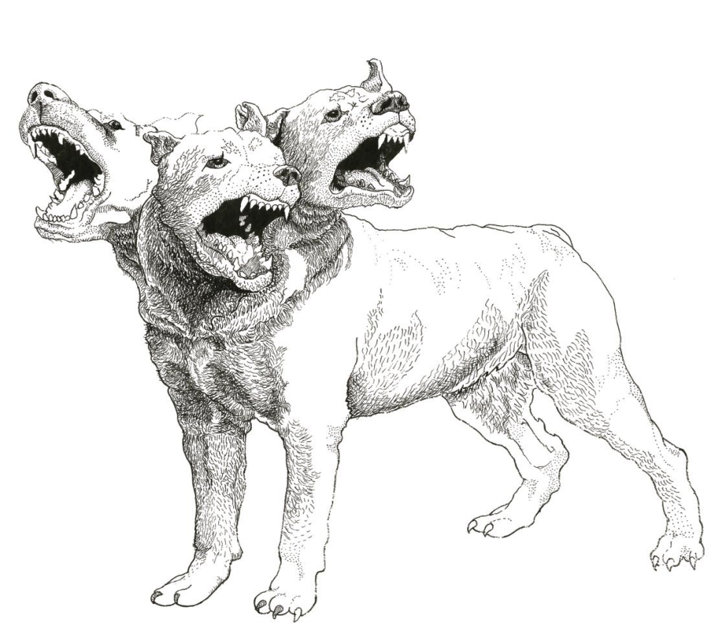
The Children left the field together trying to plot a plan to outsmart the devilish dog. It was getting close to evening and the warmth of the sun was already leaving the sky. The Library was only a short distance.
"I've got it!" Cried Artemis coming to a sudden halt. "Tell us then!" Demanded Apollo. "My dogs love to chase balls! Why would Cerberus be any different?" Artemis explained. "We'd best hurry before Uncle Hades returns to collect the scrolls." Said Athena. The children began to run.

Slide 4
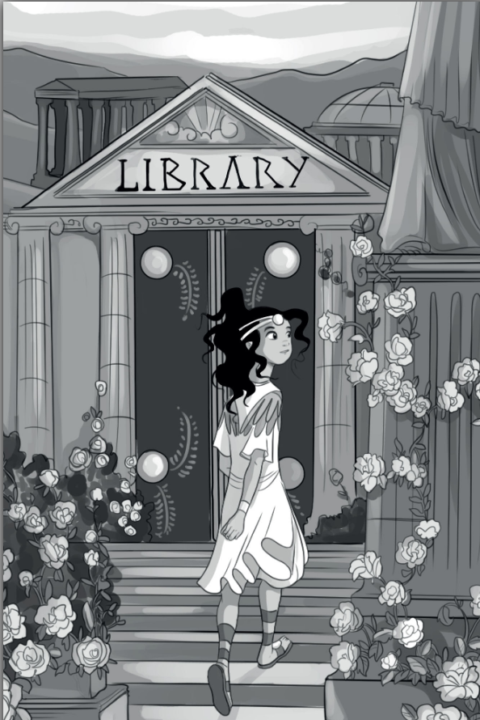
As they approach the library, the door is closed, Apollo opens it carefully, it makes a creaking noise as it moves. They stealthily enter the ancient room which was filled floor to ceiling with bookshelves. Each shelf contain mystical texts from their ancestors history. Some were so old that they were faded. The children pause at sound of the dog. Suddenly the devil dog runs towards them. Athena shouts "Artemis throw the ball!" Artemis searched her Quiver, oh no! it's not there, Artemis had forgotten she'd already thrown it back in the field for her own dogs to chase! "I don't have it!"

Slide 5
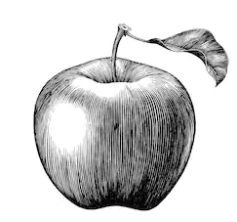
Apollo quick to respond searched around him for something to launch. There next to one of the great bookshelves in the corner was an Apple. He ran for it and grabbed it up.
Turning he shouted "Over here Cerberus!" Catching to dogs attention he through the apple through the air and straight out the door where it bounced down to step.

Slide 6
The end.
Athena reached for the scrolls on the table in the middle of the Library. Together the children left the library through the back door to avoid bumping into Cerberus. Fwww! What a relief the children had outsmarted the dog and could now take the scroll's to Professor Homer who was waiting for them.

