Slide 1
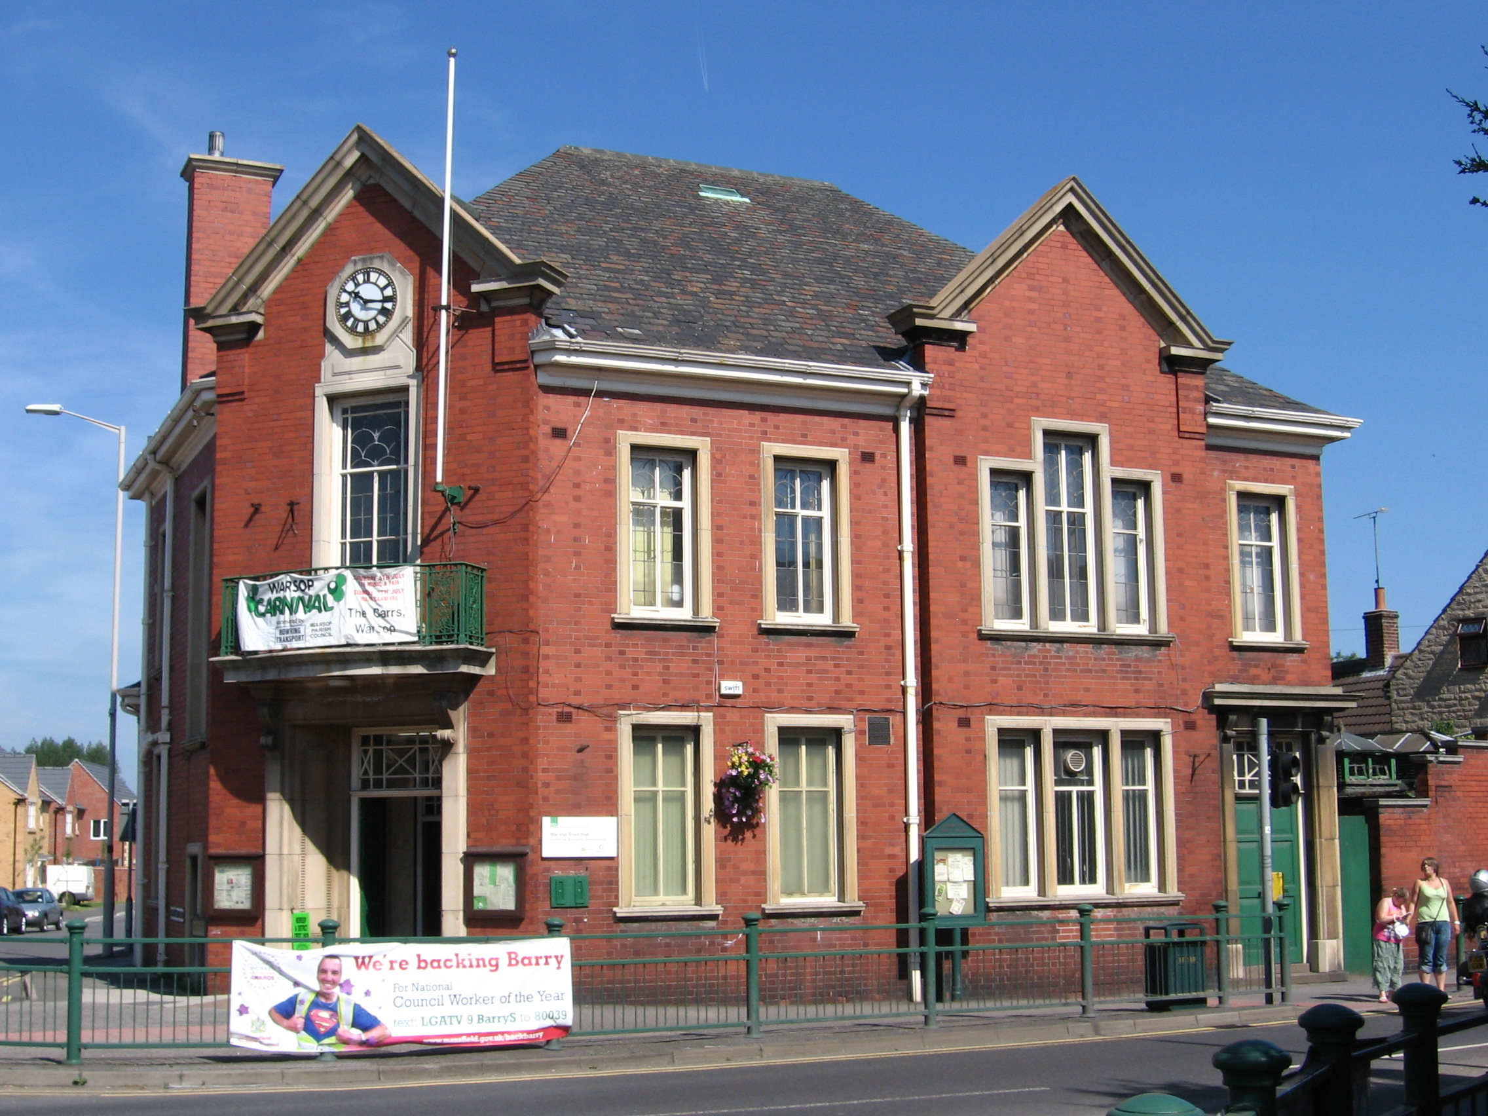
Warsop
Hugo & Riley

Slide 2
Information about Warsop
There are four schools in Warsop: Birklands, Hetts lane, Meden, Sherwood.
Warsop has a beautiful church in The Carrs.
And a town hall known for its historic information.
Warsop is located in Mansfield, Great Britain, Europe.
Warsop has so many amazing sights to see.
Warsop’s water mill was opened in 1967 and was restored 1924.
Warsop’s railway station was operated in 1887 and 1955.
Warsop has two parks.

Slide 3
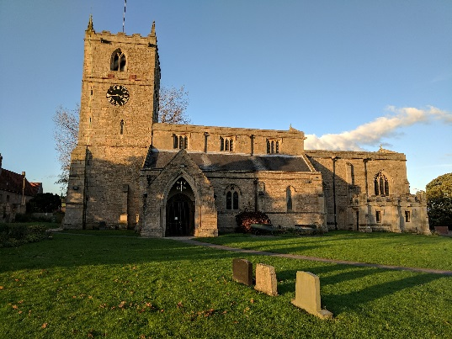
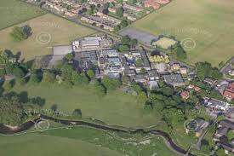
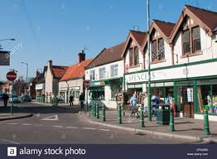
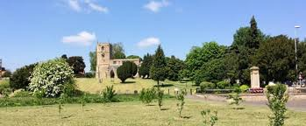
Pictures of Warsop

