Slide 1
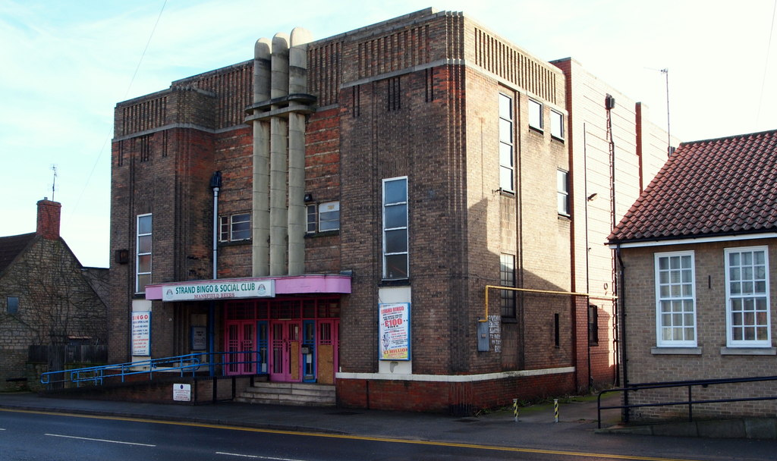
Welcome to spooky Warsop

Slide 2
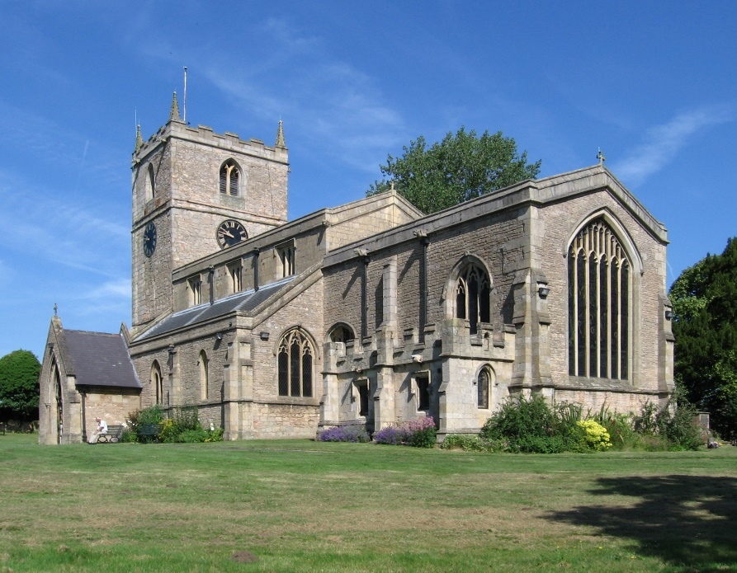
Information
Warsop is a rural place.
Warsop has a Church and The Carrs.
Warsop is a town.
Warsop has 15 shops.

